Slide 1
GRAPHS!

Slide 2
Instructor
Dr. Ab Rouf Khan
Assistant Professor
VIT Bhopal University

Slide 3
Entry level Questions
How are the various connections on the social media between the people represented?
Can we find a minimal path from every node to some other node in a graph?
Are trees and graphs one and the same thing?

Slide 4
Outline (Module 5 [Part 1])
Graph:
Introduction
Definition, Types etc.
Representations
Adjacency Matrix and Adjacency List
Traversals
BFS and DFS
Topological Sorting

Slide 5
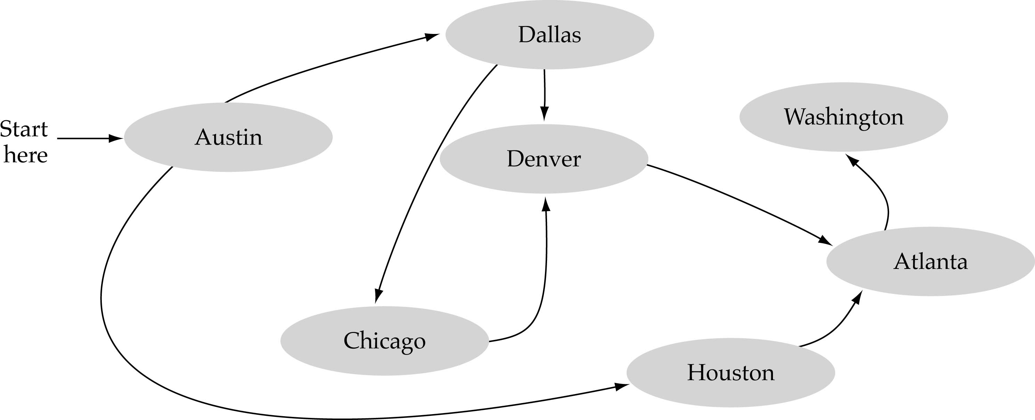
What is a graph?
A data structure that consists of a set of nodes (vertices) and a set of edges that relate the nodes to each other
The set of edges describes relationships among the vertices

Slide 6
Formal definition of graphs
A graph G is defined as follows:
G=(V,E)
V(G): a finite, nonempty set of vertices
E(G): a set of edges (pairs of vertices)

Slide 7
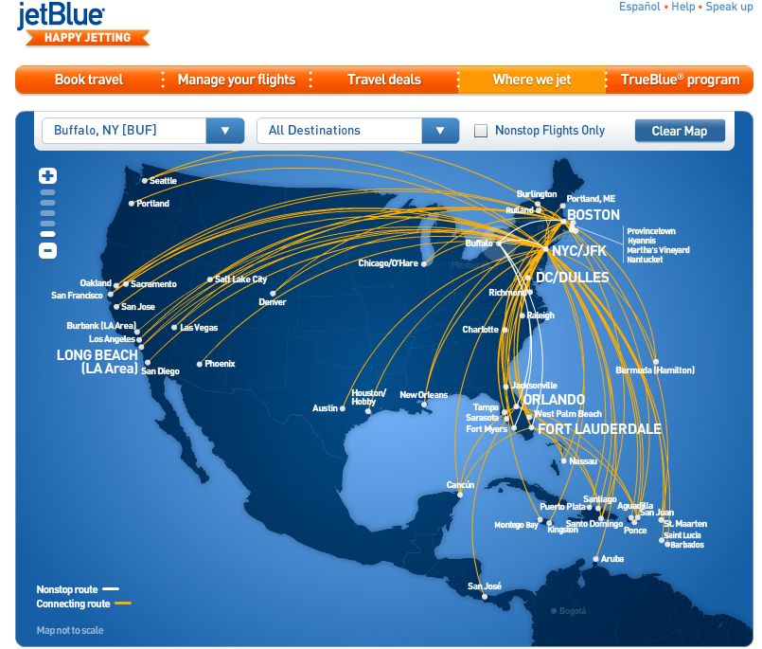
Graphs are omnipresent
Airline Route maps

Slide 8
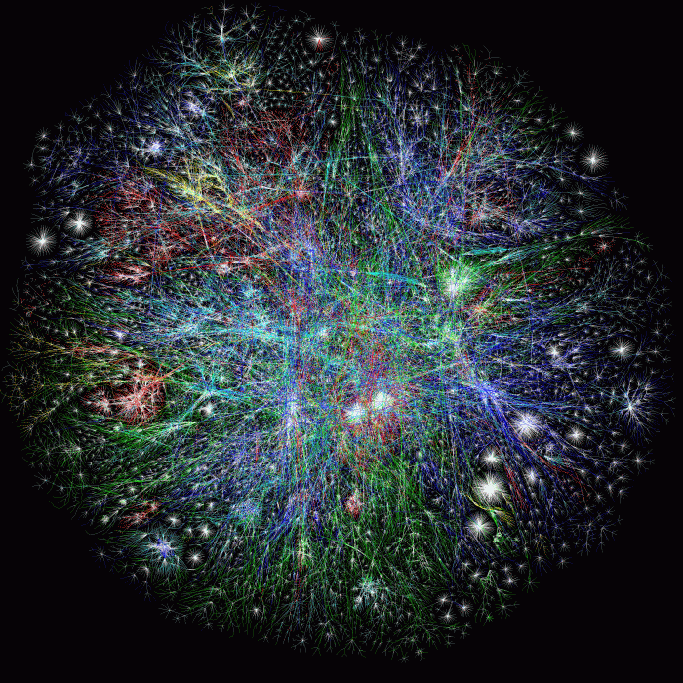
What does this graph represent?
Internet!

Slide 9
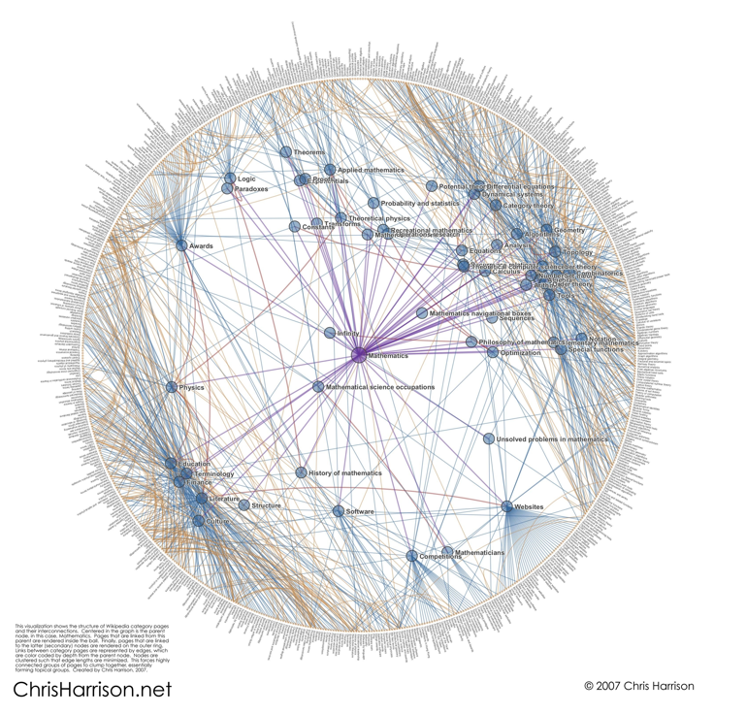
And this one?
Math articles on Wikipedia

Slide 10
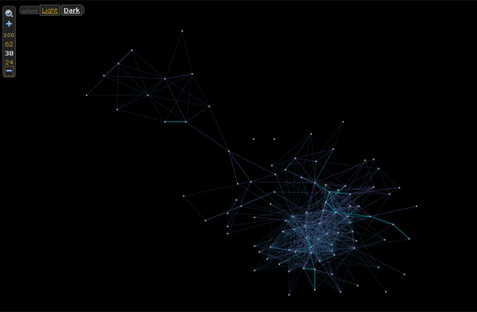

And this one?

Slide 11
Directed vs undirected Graphs
An undirected graph is one in which the pair of vertices in a edge is unordered, (v0, v1) = (v1,v0)
A directed graph is one in which each edge is a directed pair of vertices, <v0, v1> != <v1,v0>
tail
head

Slide 12
Examples for Graphs
0
0
0
1
2
1
2
1
3
3
4
5
6
G1
2
G2
complete graph
incomplete graph
G3
V(G1)={0,1,2,3} E(G1)={(0,1),(0,2),(0,3),(1,2),(1,3),(2,3)}
V(G2)={0,1,2,3,4,5,6} E(G2)={(0,1),(0,2),(1,3),(1,4),(2,5),(2,6)}
V(G3)={0,1,2} E(G3)={<0,1>,<1,0>,<1,2>}
complete undirected graph: n(n-1)/2 edges
complete directed graph: n(n-1) edges

Slide 13
Complete Graph
A complete graph is a graph that has the maximum number of edges.
for undirected graph with n vertices, the maximum number of edges is n(n-1)/2
for directed graph with n vertices, the maximum number of edges is n(n-1)
example: G1 (Slide Number 13) is a complete graph

Slide 14
Adjacent and Incident
If (v0, v1) is an edge in an undirected graph,
v0 and v1 are adjacent
The edge (v0, v1) is incident on vertices v0 and v1
If <v0, v1> is an edge in a directed graph
v0 is adjacent to v1, and v1 is adjacent from v0
The edge <v0, v1> is incident on v0 and v1

Slide 15
Figure 6.3
Graph with feedback loops and a multigraph
0
0
2
1
3
1
2
multigraph:
multiple occurrences
of the same edge
self edge
(a)
(b)

Slide 16
Subgraph and Path
Subgraph and Path of a Graph
A subgraph of G is a graph G’ such that V(G’) is a subset of V(G) and E(G’) is a subset of E(G)
A path from vertex vp to vertex vq in a graph G, is a sequence of vertices, vp, vi1, vi2, ..., vin, vq, such that (vp, vi1), (vi1, vi2), ..., (vin, vq) are edges in an undirected graph
The length of a path is the number of edges on it

Slide 17
Subgraph of a Graph (Example)
0
0
0
1
2
0
1
2
1
2
3
1
2
3
3
G1
(i) (ii) (iii) (iv)
(a) Some of the subgraphs of G₁
0
0
0
0
0
1
1
1
1
2
2
2
(i) (ii) (iii) (iv)
(b) Some of the subgraphs of G₃
G3

Slide 18
Path vs Cycle
A simple path is a path in which all vertices, except possibly the first and the last, are distinct
A cycle is a simple path in which the first and the last vertices are the same
In an undirected graph G, two vertices, v0 and v1, are connected if there is a path in G from v0 to v1
An undirected graph is connected if, for every pair of distinct vertices vi, vj, there is a path from vi to vj

Slide 19
Connected Component
A connected component of an undirected graph is a maximal connected subgraph.
A tree (Acyclic Graph) is a graph that is connected and acyclic.
A directed graph is strongly connected if there is a directed path from vi to vj and also from vj to vi.
A strongly connected component is a maximal subgraph that is strongly connected.

Slide 20
Connected Component - Example
connected component (maximal connected subgraph)
H₁
0
H₂
4
2
1
5
3
6
7
G₄ (not connected)

Slide 21
Strongly Connected Component - Example
strongly connected component
(maximal strongly connected subgraph)
not strongly connected
0
0
2
1
1
2
G3

Slide 22
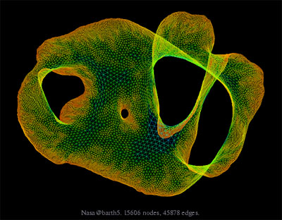
What about large graphs?
s
t
Are s and t connected?

Slide 23
Degree of a Graph
The degree of a vertex is the number of edges incident to that vertex
For directed graph,
the in-degree of a vertex v is the number of edges that have v as the head
the out-degree of a vertex v is the number of edges that have v as the tail
if di is the degree of a vertex i in a graph G with n vertices and e edges, the number of edges is

Slide 24
Degree of a Graph - Example
degree
3
undirected graph
0
0
2
1
2
3
1
2
3
3
3
3
4
5
6
3
3
1
1
G1
1
G2
1
0
in:1, out: 1
directed graph
in-degree
out-degree
1
in: 1, out: 2
2
in: 1, out: 0
G3

Slide 25
ADT for a Graph
structure Graph is:
objects: a nonempty set of vertices and a set of undirected edges, where each edge is a pair of vertices
functions: for all graph ∈ Graph, v, v₁ and v₂ ∈ Vertices
Graph Create()::=return an empty graph
Graph InsertVertex(graph, v)::= return a graph with v inserted v has no incident edge.
Graph InsertEdge(graph, v1,v2)::= return a graph with new edge between v1 and v2
Graph DeleteVertex(graph, v)::= return a graph in which v and all edges incident to it are removed
Graph DeleteEdge(graph, v1, v2)::=return a graph in which the edge (v1, v2) is removed
Boolean IsEmpty(graph)::= if (graph==empty graph) return TRUE else return FALSE
List Adjacent(graph,v)::= return a list of all vertices that are adjacent to v

Slide 26
Graph Representations
Adjacency Matrix
Adjacency Lists

Slide 27
Adjacency Matrix
Let G=(V,E) be a graph with n vertices.
The adjacency matrix of G is a two-dimensional n by n array, say adj_mat
If the edge (vi, vj) is in E(G), adj_mat[i][j]=1
If there is no such edge in E(G), adj_mat[i][j]=0
The adjacency matrix for an undirected graph is symmetric; the adjacency matrix for a digraph need not be symmetric

Slide 28
Adjacency Matrix – Examples
0
0
4
0
2
1
5
1
2
3
6
3
1
7
2
G2
G1
symmetric
G4

Slide 29
Merits of Adjacency Matrix
From the adjacency matrix, to determine the connection of vertices is easy
The degree of a vertex is
For a digraph, the row sum is the out_degree, while the column sum is the in_degree

Slide 30
Data Structures for Adjacency Lists
Each row in adjacency matrix is represented as an adjacency list.
#define MAX_VERTICES 50
typedef struct node *node_pointer;
typedef struct node {
int vertex;
struct node *link;
};
node_pointer graph[MAX_VERTICES];
int n=0; /* vertices currently in use */

Slide 31
0
4
0
5
2
1
1
2
3
6
3
7
0
1
2
3
1
2
3
0
1
2
3
4
5
6
7
1
2
0
2
3
0
3
0
1
3
0
3
0
1
2
1
2
G1
0
5
4
6
0
1
2
1
5
7
0
2
1
6
G3
G4
2
An undirected graph with n vertices and e edges ==> n head nodes and 2e list nodes

Slide 32
Adjacency Matrix vs Adjacency List
0
1
1
1
0
0
1
0
0
Adjacency Matrix
Adjacency List

Slide 33

Recap

Slide 34
Thank You

